Slide 1

Lab 6: Multiplexors and ALUs
CSE 2301 – Fall 2024

Slide 2
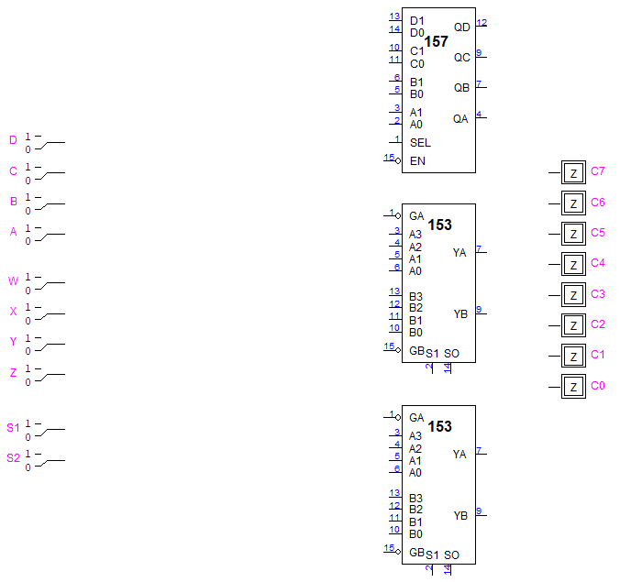
Introduction: overview
In this lab, you will be responsible for designing an ALU (Arithmetic Logic Unit) with adders, multiplexors, and combinational logic.
You’ll also be employing a new chip called a 74153 in this lab, which is a “dual 4-input MUX”.
Foundational knowledge of binary multiplication and multiplexing is required for this lab. You will with hardware implementation, but the rest of the lab is largely conceptual.

Slide 3
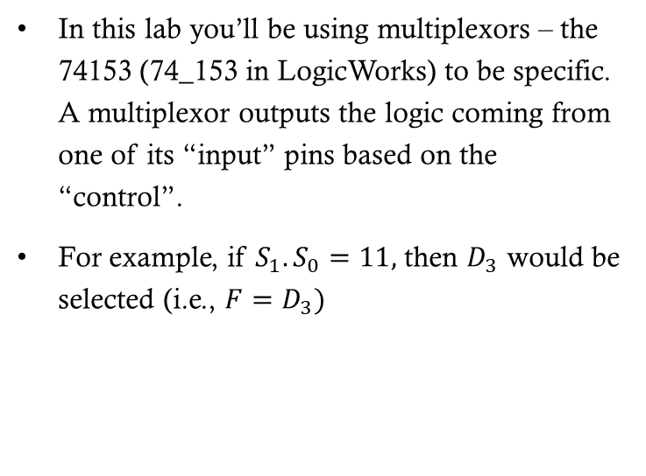
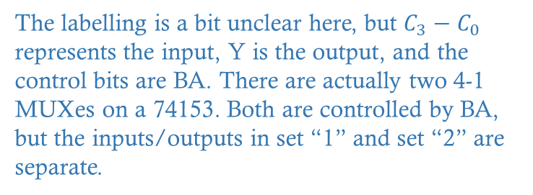
review: Multiplexors
Be sure to ground
the strobes!!
In this lab you’ll be using multiplexors – the 74153 (74_153 in LogicWorks) to be specific. A multiplexor outputs the logic coming from one of its “input” pins based on the “control”.
For example, if $S_{1}.S_{0}=11,$ then $D_{3}$ would be selected (i.e., $F=D_{3})$
The labelling is a bit unclear here, but $C_{3}−C_{0}$ represents the input, Y is the output, and the control bits are BA. There are actually two 4-1 MUXes on a 74153. Both are controlled by BA, but the inputs/outputs in set “1” and set “2” are separate.

Slide 4
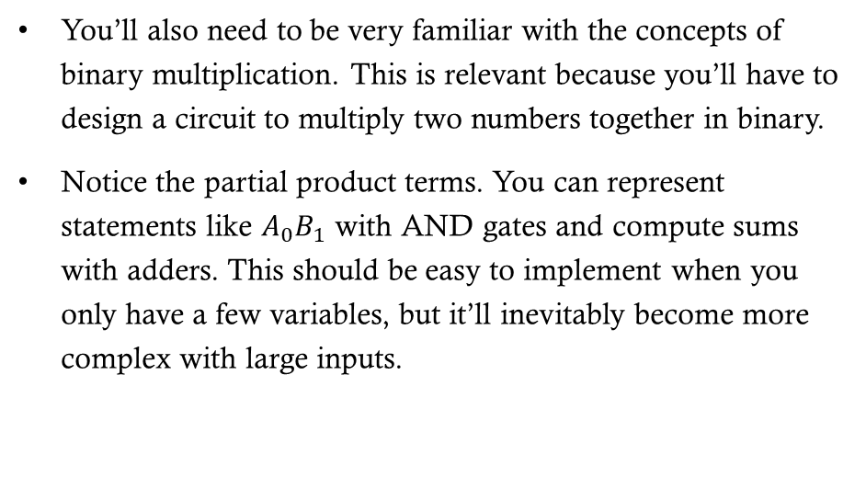
review: Multiplication
You’ll also need to be very familiar with the concepts of binary multiplication. This is relevant because you’ll have to design a circuit to multiply two numbers together in binary.
Notice the partial product terms. You can represent statements like $A_{0}B_{1}$ with AND gates and compute sums with adders. This should be easy to implement when you only have a few variables, but it’ll inevitably become more complex with large inputs.

Slide 5
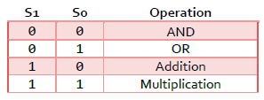
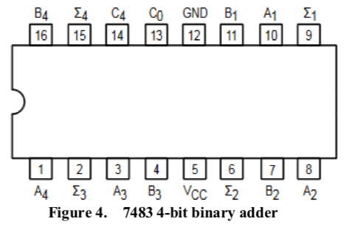
Part 1: BASIC ALU
Your task is to design a simple ALU and then implement it as hardware. An Arithmetic Logic Unit performs different functions based on the provided selector input.
The ALU should be able to perform AND, OR, addition, and multiplication operations on two 2-bit binary inputs. It’s up to you to figure out how to implement this based on the reviewed topics.
You’ll need a 7483/74283 adder chip for your binary multiplication implementation. There is a difference, so pay close attention!

Slide 6
Part 2: COMPLEX Multiplier
TAs are under strict instructions to NOT draw the schematic to students. Guidance is allowed, but providing the answer is not.
Create a multiplier circuit for a 4-bit and a 4-bit input. It will be more complex than the first one you created, because now you’ll need multiple adders. In principle, however, the design is the same.
Break operations up based on the partial products.
You will NOT implement this in hardware (you don’t have enough chips), but you will demo the LogicWorks design and explain how it could work for any input size.

Slide 7
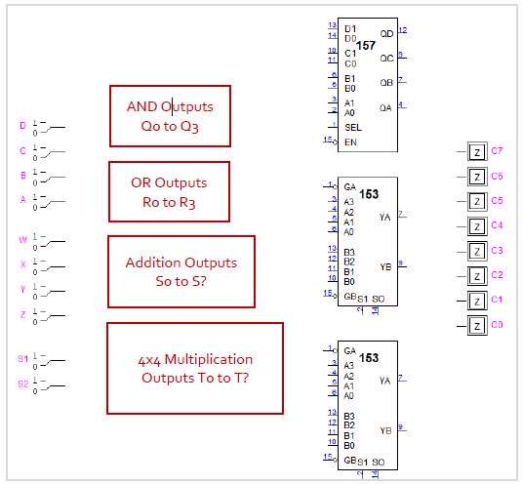
Part 3: Complex Multiplexors
Next, you will have to figure out how to wire an ALU for two sets of 4-bit inputs. You do not need to implement anything. This is part of your report. Assume that the AND, OR, addition, and multiplication subcircuits have been designed for you.
Your responsibility is to figure out how to wire the output to multiplexors. Note that max output size is 8 bits.
The 74_157 on this diagram is a different kind of multiplexor called quad 2-1 MUX. It takes two sets of 4-bit inputs and outputs only one set based on the SEL input.

Slide 8

Other notes AND report information
This is a highly conceptual lab. You only need to demo the hardware for part 1 and the software in part 2. Be sure to set aside sufficient time for the report proper.
Demos and reports for this lab due next Thursday/Friday.

